Slide 1
DATA ANALYSIS NORTHWIND
Name: pruthvi raj kn
class: BCA iv SEMESTER
a-SECTION

Slide 2
DATASET OVERVIEW
Northwind is a fictional business specializing in a variety of products,
Including beverages,condiments,confections,dairy products,cereals, meat,prosuce,and seafood. The dataset includes files such as Categories,customer,details,employee details,orders,and products. questions were provided to query the dataset

Slide 3
TOOLS USED
SQL MANAGEMENT SERVER

Slide 4
STEPS FOLLOWED
IMPORTED NORTHWIND DATASET INTO SQL SERVER
USED SQL FUNCTIONS TO QUERY DATASET AND ANSWER THE QUESTIONS

Slide 5
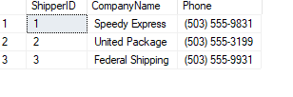
1. Which shippers do we have?

Slide 6
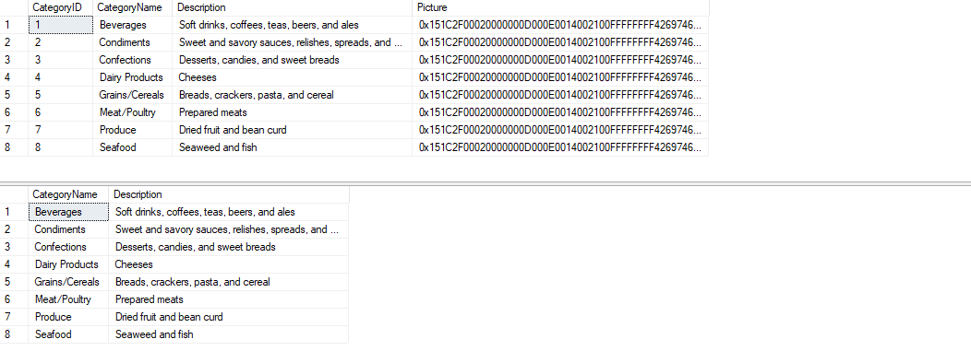
2. Certain fields from Categories?

Slide 7
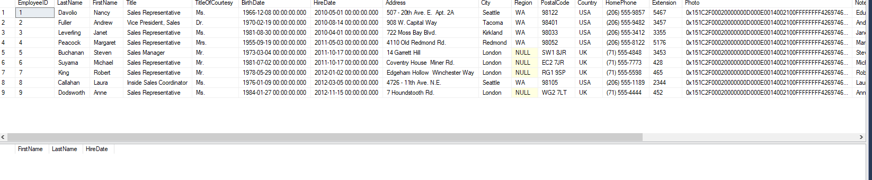
3. Sales Representatives

Slide 8

4. Sales Representatives in the United States

Slide 9
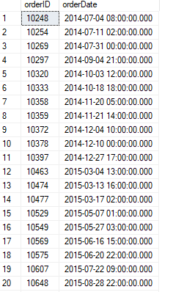
5. Orders placed by specific EmployeeID

Slide 10
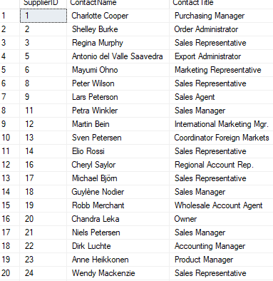
6. Suppliers and ContactTitles

Slide 11

7. products with “queso” in ProductName

Slide 12
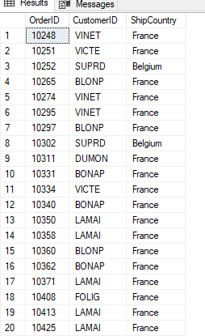
8.Orders shipping to France or Belgium

Slide 13
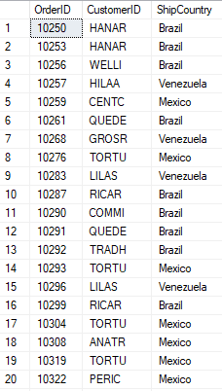
9.SELECT OrderID, CustomerID, ShipCountry

Slide 14
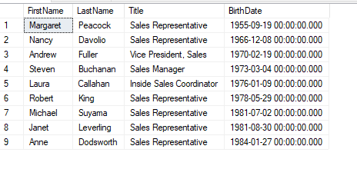
10.SELECT FirstName, LastName, Title, BirthDat

Slide 15
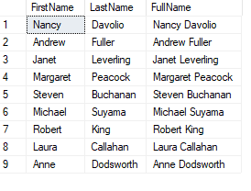
12.SELECT FirstName, LastName, FirstName + ' ' + LastName AS FullName

Slide 16

14 How many customers?

Slide 17

15 When was the first order?

Slide 18
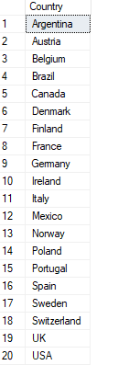
16 Countries where there are customers

Slide 19
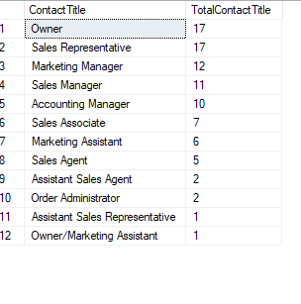
17 Contact titles for customers

Slide 20
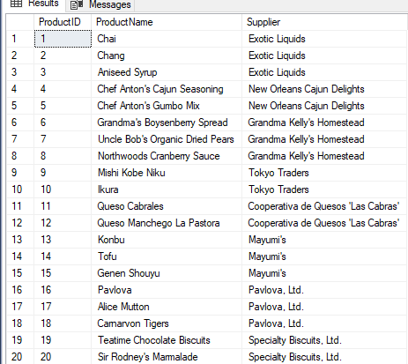
18 Products with associated supplier names

Slide 21
THANK YOU

